Slide 1
Public health education in high schools: A curriculum about root causes of health and social advocacy
Nell Curran, MPH, School Outreach Director
Marilyn Winkleby, PhD, MPH, Faculty Director
Judith Ned, EdD, MEd, Executive Director
Stanford Medical Youth Science Program (SMYSP)
Stanford Prevention Research Center

Slide 2
Agenda
Background
Curriculum Overview
Curriculum Delivery
Implementation
Adaptation
Dissemination
Discussion

Slide 3
The Need for Public Health Curricula
Many K-12 health curricula focus on individual risk assessment and behavior change
Limited emphasis on social, economic, and political factors (i.e., upstream causes) affecting health outcomes
2003 IOM report suggested undergraduate programs include public health and mobilized a national task force to act - why not expect the same for high school health education?

Slide 4
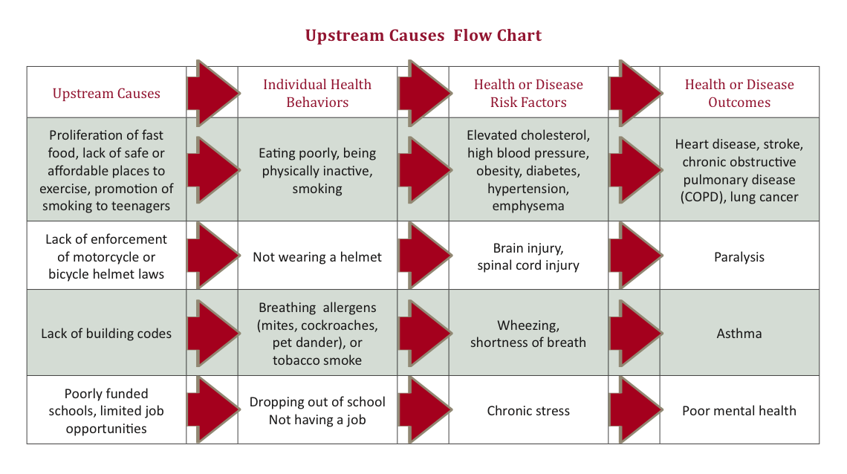
Upstream Causes Flow Chart

Slide 5
Curriculum Overview

Slide 6
Curriculum Content
10 hands-on, interactive, modular lessons
Freirian pedagogy, project-based learning, think-pair-share
Key messages:
The health of an individual is embedded within a broad context
Students can advocate for improved conditions in their school and local neighborhood to help improve personal and community health
3 primary domains:
Upstream Causes of Health
Community Exploration
Health and Social Advocacy

Slide 7
Table of Contents
Domain Topics | Lesson # | Lesson Title
Domain1: Upstream Causes of Health | 1 | Introduction to Health
 | 2 | Food Availability, Obesity, and Diabetes
 | 3 | Environmental Hazards and Regulatory Measures
 | 4 | Smoking, Drinking, and the Media
 | 5 | Perceiving Communities Through a Public Health Lens
Domain 2: Community Exploration | 6 | Identifying Community Assets and Barriers
 | 7 | Leveraging Community Assets and Barriers
Domain 3: Health and Social Advocacy | 8 | Understanding Health and Social Advocacy
 | 9 | From Start to Finish: Health Advocacy Projects
 | 10 | Upstream Causes and Health Advocacy in Review

Slide 8
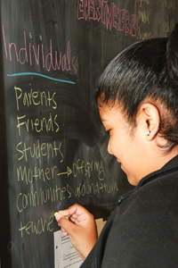
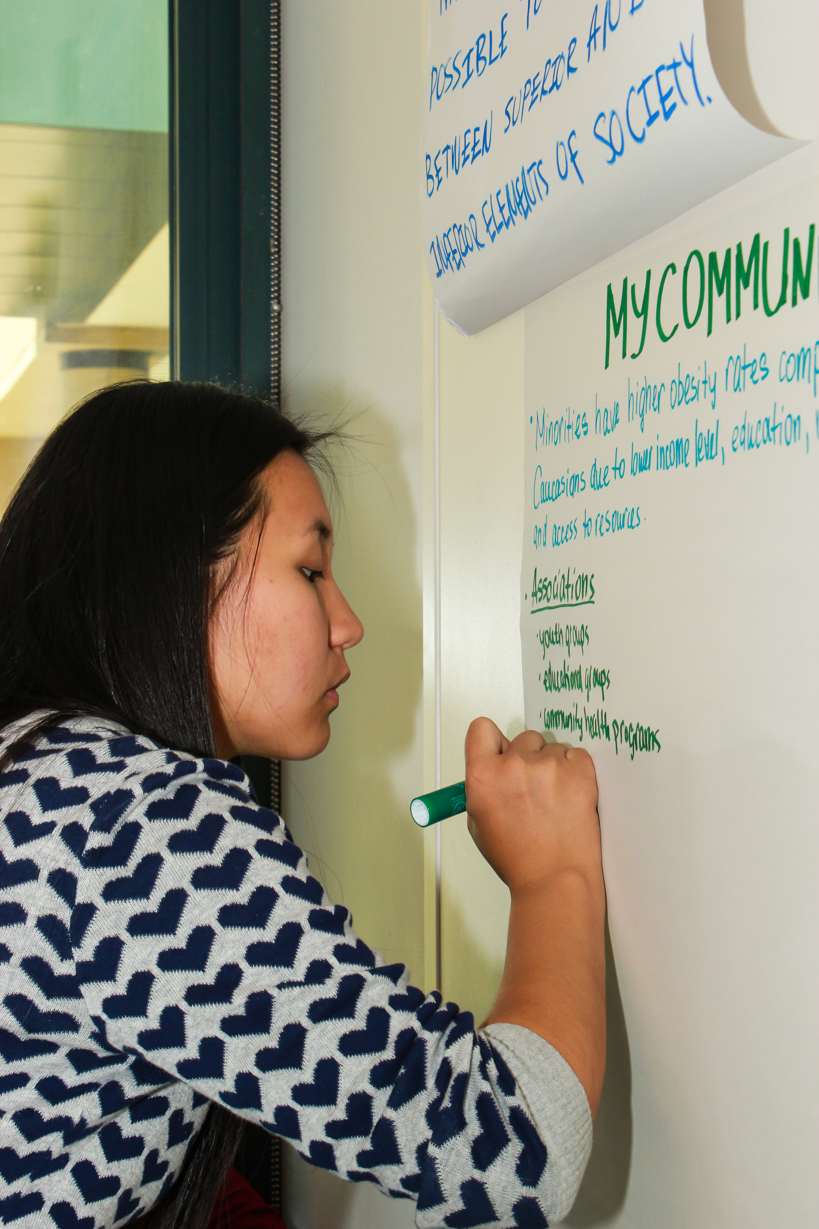
Unit One: Upstream Causes of Health
Classroom-based activities inform students about
upstream causes of health

Slide 9
Upstream Causes: Example Activities
Hypothetical Story : Students build foundational understanding of
upstream causes by reading a quintessential, fictitious public health
story that illustrates the differences between treatment of
individuals versus prevention of poor health in populations
Case Study: Students apply their understanding of upstream causes
of health to a case study about Native American tribes in Arizona
with high rates of diabetes
News Article: Students analyze news articles about environmental
health hazards (e.g., E. Coli) and identify social, economic, and
political, factors that may influence health and disease outcomes

Slide 10
Upstream Causes Framework
Social, Economic, and Political Factors
Individual Health Behaviors
Health or Disease Risk Factors
Health or Disease Outcomes

Slide 11
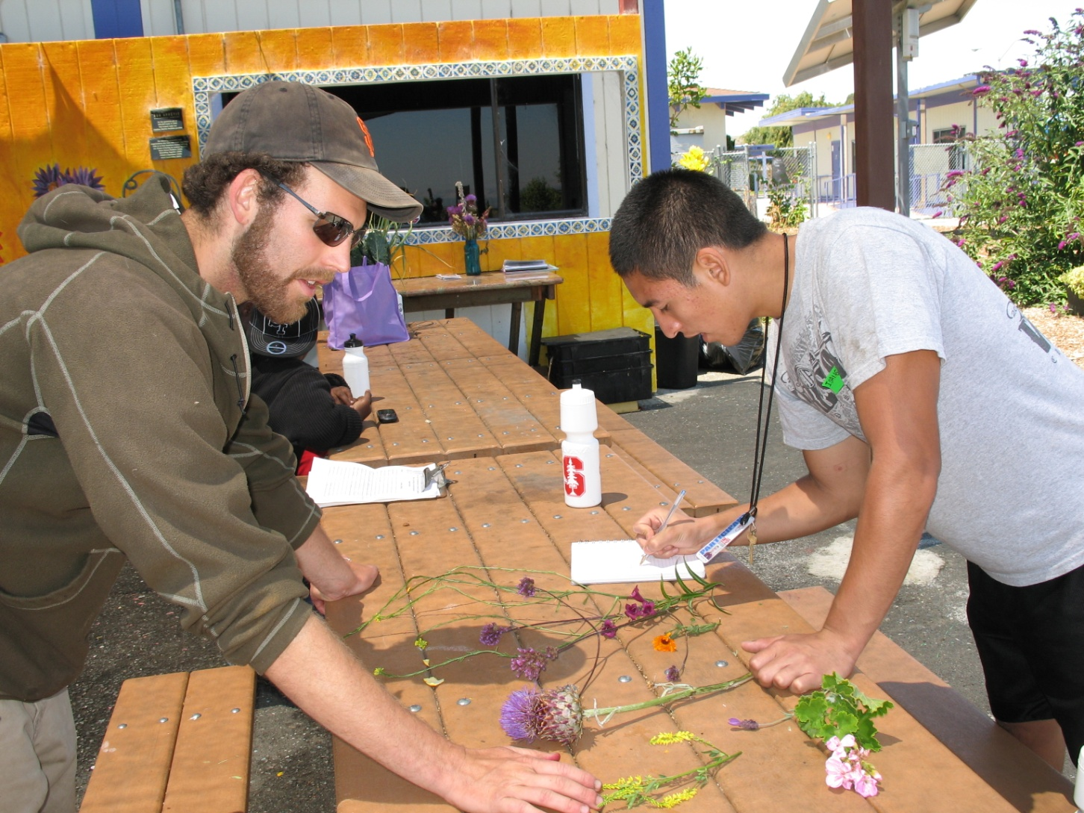
Unit Two: Community Exploration
Community-based activities allow students to explore their own communities to identify assets and barriers to health

Slide 12
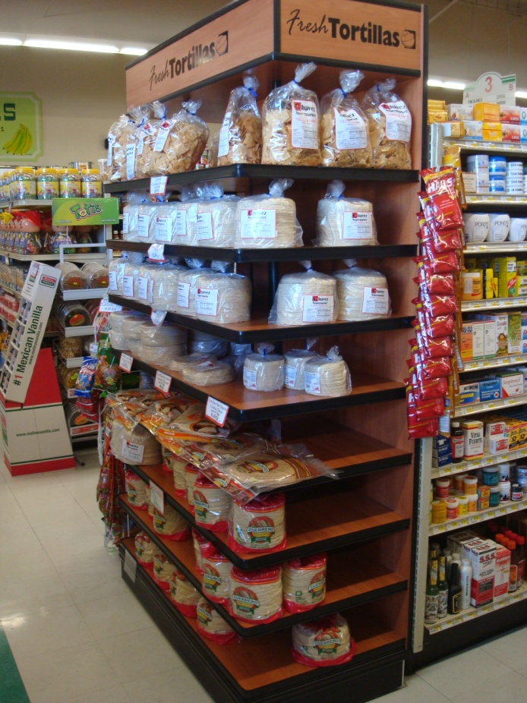
PhotoVoice Example
Students photograph assets and
barriers to health found in their
own communities, such as corner
stores that sell culturally relevant
goods (asset), and abandoned
lots where gang and drug activity
flourishes (barrier)

Slide 13
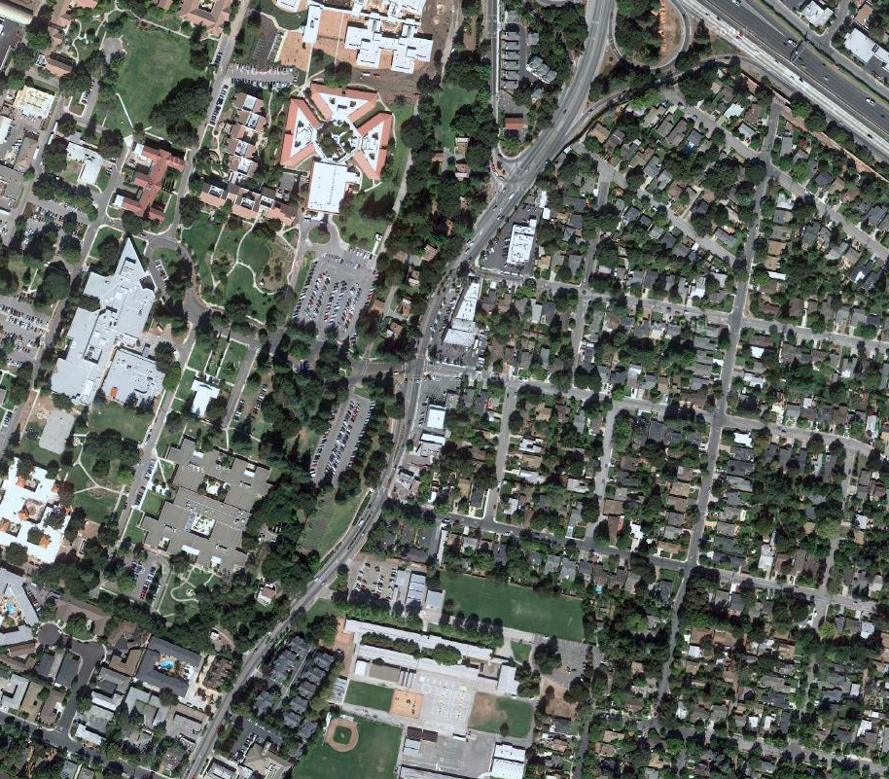
Mapping Example
Students use maps to
indicate assets and
barriers to health found
in their community,
such as a drop-in
wellness clinic with
bilingual services (asset)
or lack of sports fields or
bicycle lanes (barriers)

Slide 14
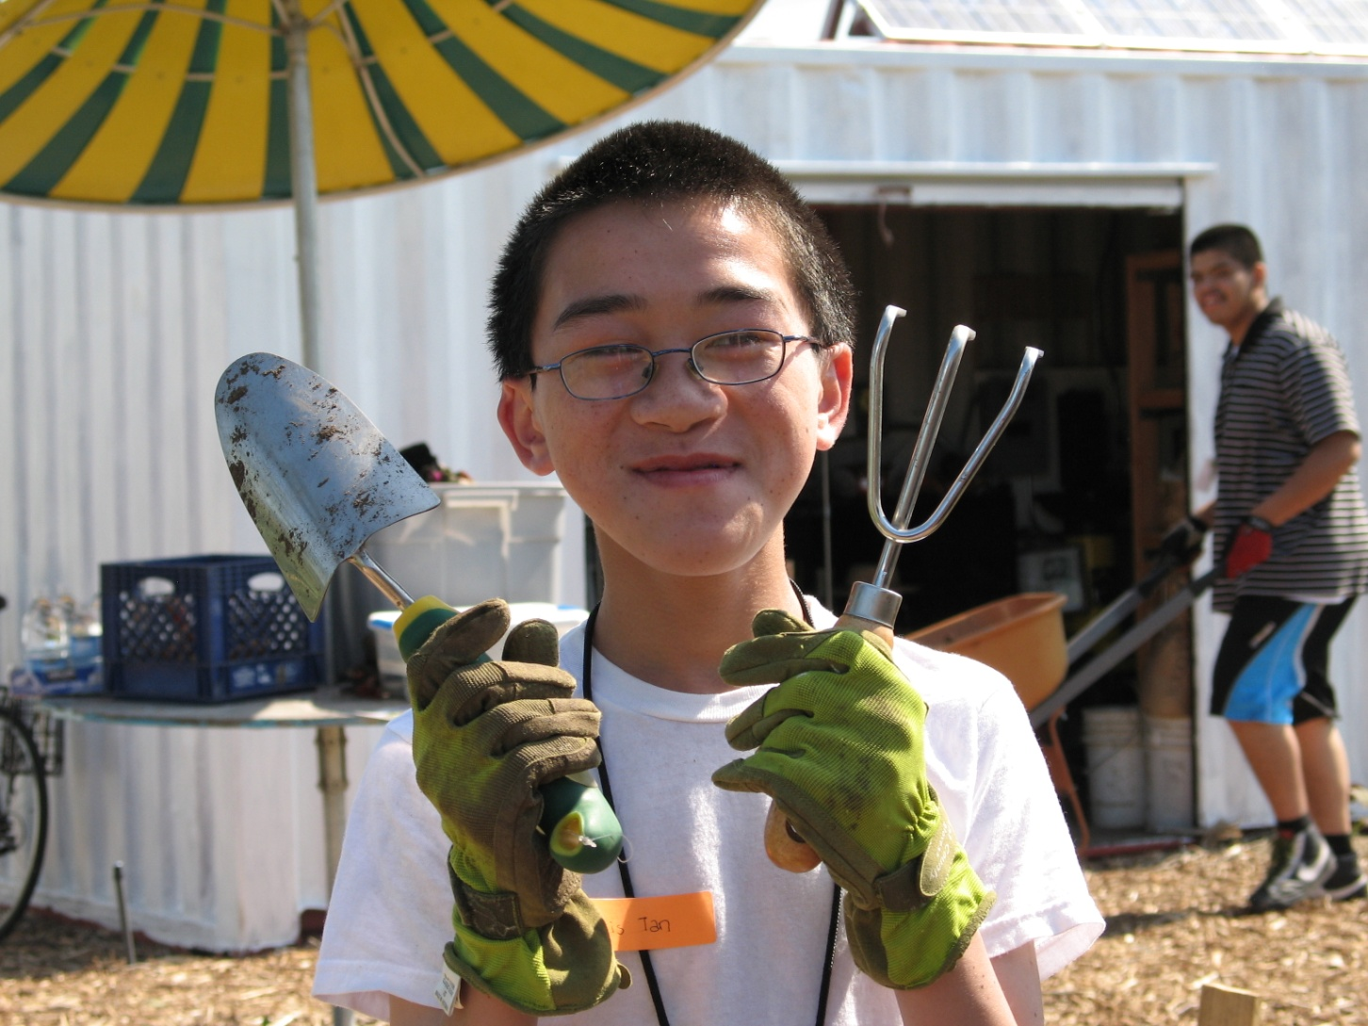
Unit Three: Health and Social Advocacy
Students define and develop advocacy projects to enhance the health of their communities

Slide 15
Advocacy Continuum
Students implement projects at each of three levels of advocacy
Level: Individual
Definition: Action that benefits yourself or a single person.
Example: One student exercises independently after school.
Level: Service
Definition: Action that benefits a small group.
Example: A consortium of high schools provides free intramural athletic programs for all interested students.
Level: Activism
Definition: Sustainable action that benefits a large group of people.
Example: State laws require schools to integrate physical activity breaks into regular academic schedules, such as 5 minute breaks to stretch and walk at the start of each class. Instructors are held accountable by school administration to enforce these regulations.

Slide 16
Sample Health Advocacy Project
Health Issue: Toxic effects of Bisphenol A in commercial products
Individual: Developed an educational presentation about the potential health effects of carcinogenic chemicals found in plastic water bottles and encouraged students and parents attending an afterschool seminar to use reusable alternatives, such as aluminum, glass, or chemical-free bottles.
Service: Requested that his high school provide tap water sources, such as (chemical-free) large coolers used at sporting events, to make this option feasible for students and visitors.
Activism: Urged school administrators to pledge to only use chemical-free water bottles when necessary, with the hope that action taken at his school will serve as a springboard for broader-reaching regulations whereby all schools district-wide will be required to limit plastic water bottle sales to those without chemicals, and to promote tap water use by funding public coolers.

Slide 17
Curriculum Delivery

Slide 18
Implementation of Curriculum
Academic enrichment classes
Traditional high school
Low-income, predominantly Latino, urban
44 students, daily classes for one academic unit (8 weeks)
Evaluation complete
Health classes
Health-themed charter school
Low-income, predominantly Latino, semi-rural
66 students, weekly classes throughout academic year
Evaluation complete

Slide 19
Pilot: Survey Results
Survey Question | Baseline | Post | Pvalue
I am knowledgeable about public health | 70% | 93% | .001
I am confident I can help improve the health of my community | 34% | 73% | <.0001
I can explain how different aspects of my community can influence health | 36% | 73% | <.0001
I know how to create awareness and advocate for change to address health issues | 23% | 68% | <.0001
I know how to identify goods and services in my community that may affect health | 41% | 91% | <.0001

Slide 20
Implementation of Curriculum
Health and public service academy classes
Traditional public school
Low-income, predominantly African-American, urban
150 students, daily classes for one semester
Not formally evaluated
100+ schools and programs nationwide using Curriculum components
Not evaluated

Slide 21
Modification of Curriculum
Adopted one unit to supplement existing material
Utilized advocacy lessons from Domain 3 Health and Social Advocacy for HIV/AIDS prevention and leadership course
After-school program in Chapel Hill, NC
Adapted entire Curriculum to focus on single topic
Tailoring all lessons to the topic of teen pregnancy
Academic support classes in a public school in San Jose, CA

Slide 22
Modification of Curriculum
Adapted multiple lessons for a summer class
Curriculum content condensed into intensive one month summer program
Summer Health Advocacy Enrichment Program
15 students, hosted at Stanford University in 2011
Created peer-led version of select lessons
Student-led, after-school workshops based on multiple curriculum lessons, independent of teachers
Pilot testing in process with Bay Area Schools

Slide 23
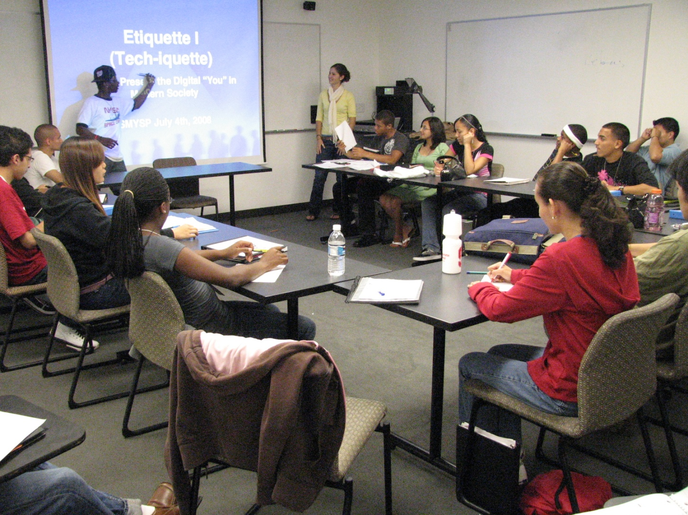
Dissemination of Curriculum
Posted on-line
SMYSP, Stanford affiliates, UCB Career Academy Network, California Newsreel, NextGen University
Seeking local and national partnerships with classes, schools, programs, etc.

Slide 24
Discussion
Where do you locate resources for public health and other lessons?
What public health efforts exist at your school?
How could the Curriculum be utilized in your classes?
Suggestions for dissemination?
Other questions?

Slide 25
Thank You

